Slide 1
Doosan Robotics
Study
2025.04.30
이재호

Slide 2
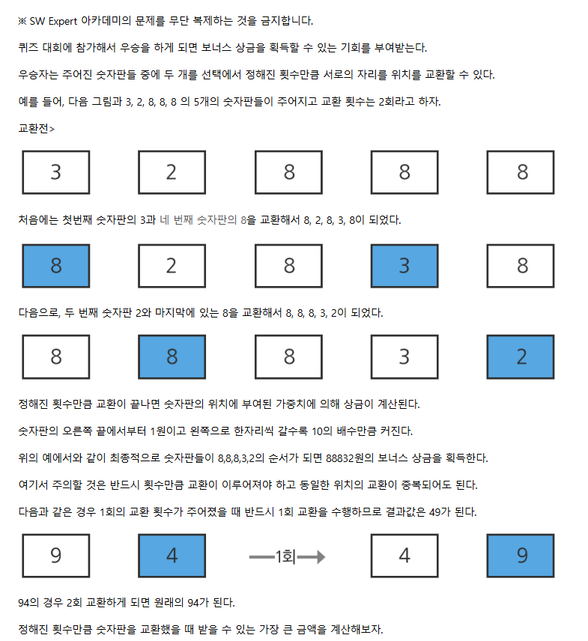
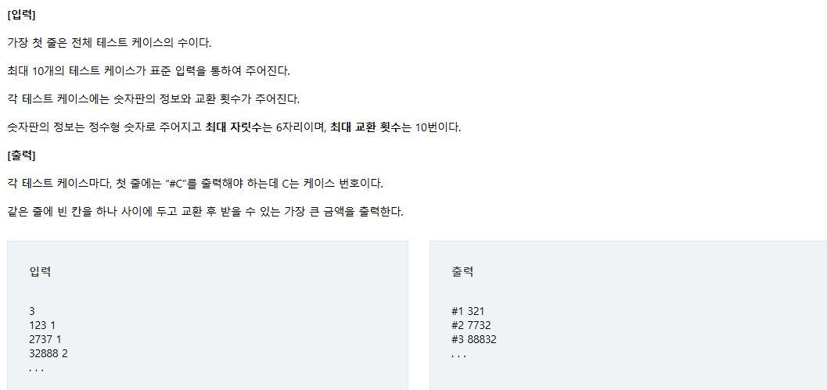
1
삼성 코딩 문제 풀이
문제
https://swexpertacademy.com/main/code/problem/problemDetail.do?problemLevel=4&contestProbId=AV15Khn6AN0CFAYD&categoryId=AV15Khn6AN0CFAYD&categoryType=CODE&problemTitle=&orderBy=FIRST_REG_DATETIME&selectCodeLang=ALL&select-1=4&pageSize=10&pageIndex=2&&&&&&&&&&

Slide 3
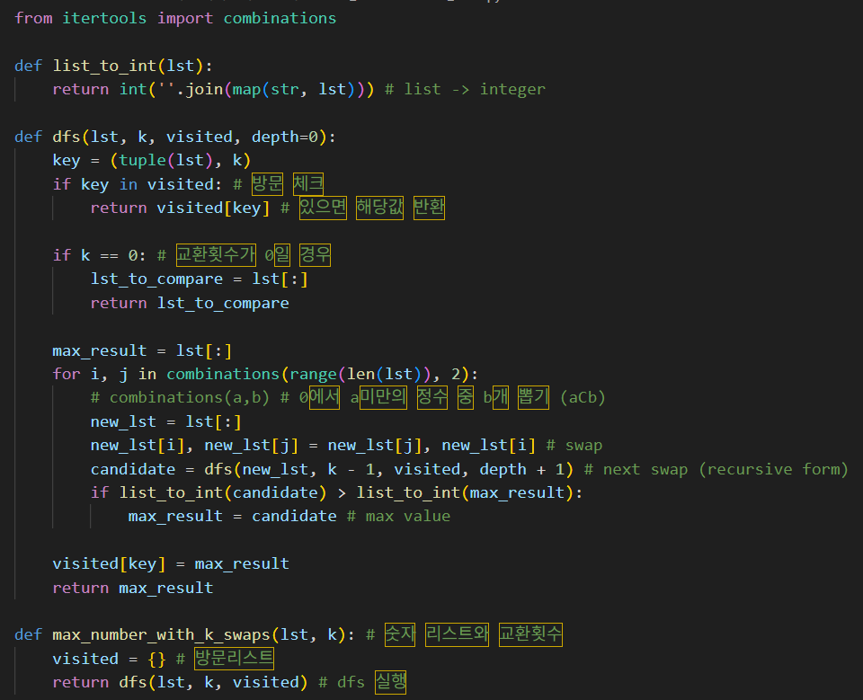
1
삼성 코딩 문제 풀이
해설
https://swexpertacademy.com/main/code/problem/problemDetail.do?problemLevel=4&contestProbId=AV15Khn6AN0CFAYD&categoryId=AV15Khn6AN0CFAYD&categoryType=CODE&problemTitle=&orderBy=FIRST_REG_DATETIME&selectCodeLang=ALL&select-1=4&pageSize=10&pageIndex=2&&&&&&&&&&

Slide 4
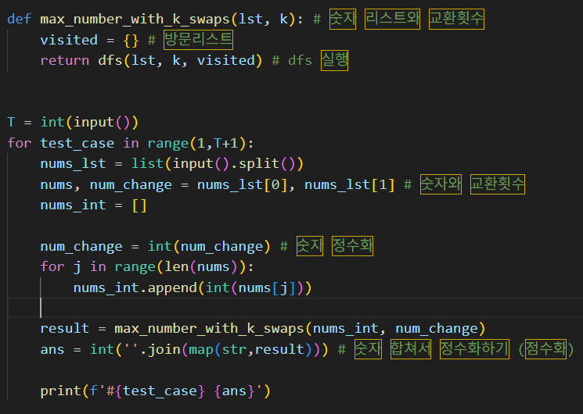
1
삼성 코딩 문제 풀이
해설
https://swexpertacademy.com/main/code/problem/problemDetail.do?problemLevel=4&contestProbId=AV15Khn6AN0CFAYD&categoryId=AV15Khn6AN0CFAYD&categoryType=CODE&problemTitle=&orderBy=FIRST_REG_DATETIME&selectCodeLang=ALL&select-1=4&pageSize=10&pageIndex=2&&&&&&&&&&

Slide 5
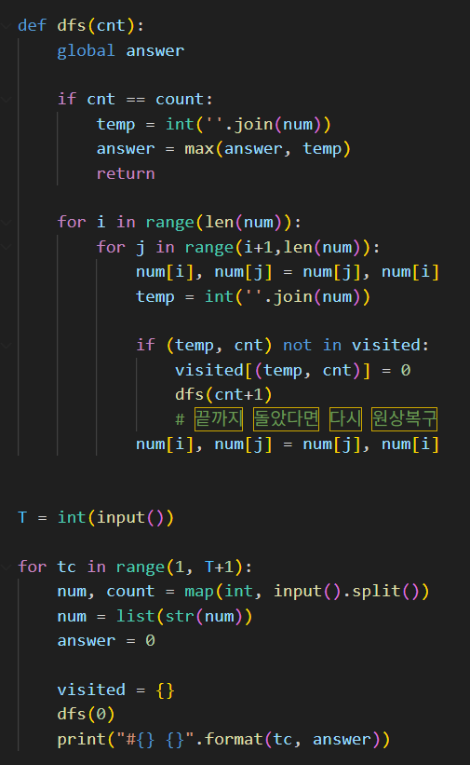
1
삼성 코딩 문제 풀이
해설
https://swexpertacademy.com/main/code/problem/problemDetail.do?problemLevel=4&contestProbId=AV15Khn6AN0CFAYD&categoryId=AV15Khn6AN0CFAYD&categoryType=CODE&problemTitle=&orderBy=FIRST_REG_DATETIME&selectCodeLang=ALL&select-1=4&pageSize=10&pageIndex=2&&&&&&&&&&

Slide 6
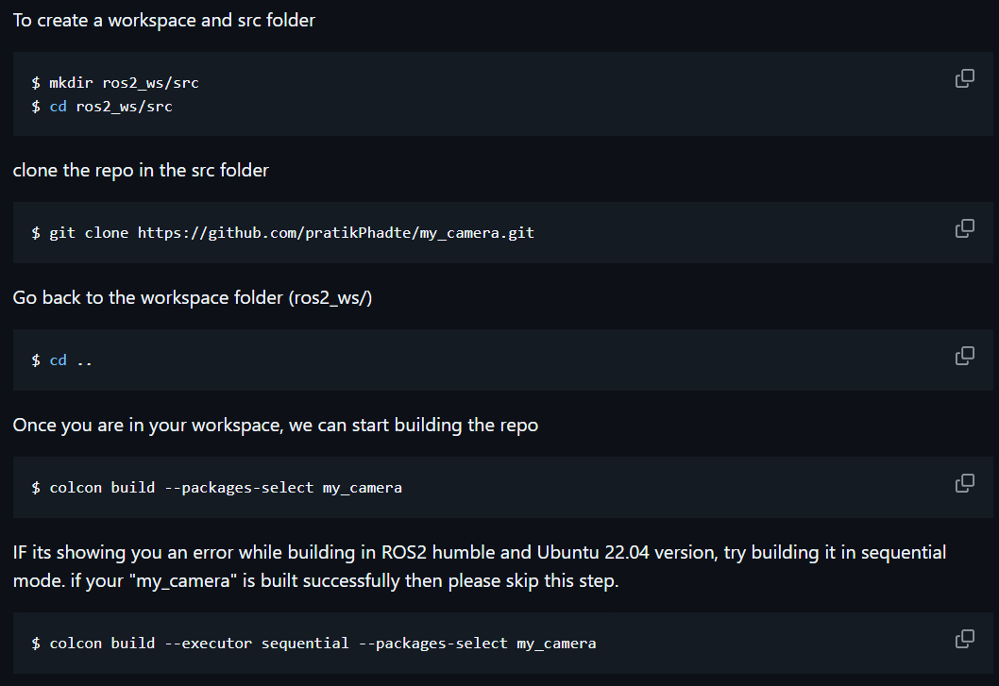
2
Robotics
ROS2
webcam
https://github.com/pratikPhadte/my_camera/tree/main

Slide 7
2
Robotics
ROS2
webcam
https://github.com/pratikPhadte/my_camera/tree/main

Slide 8
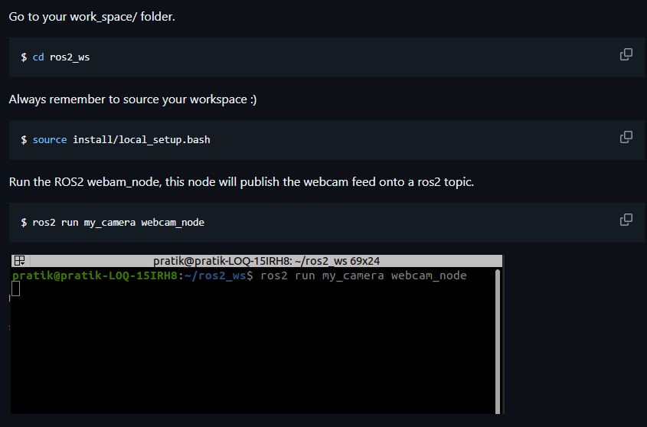
2
Robotics
ROS2
webcam
https://github.com/pratikPhadte/my_camera/tree/main

Slide 9
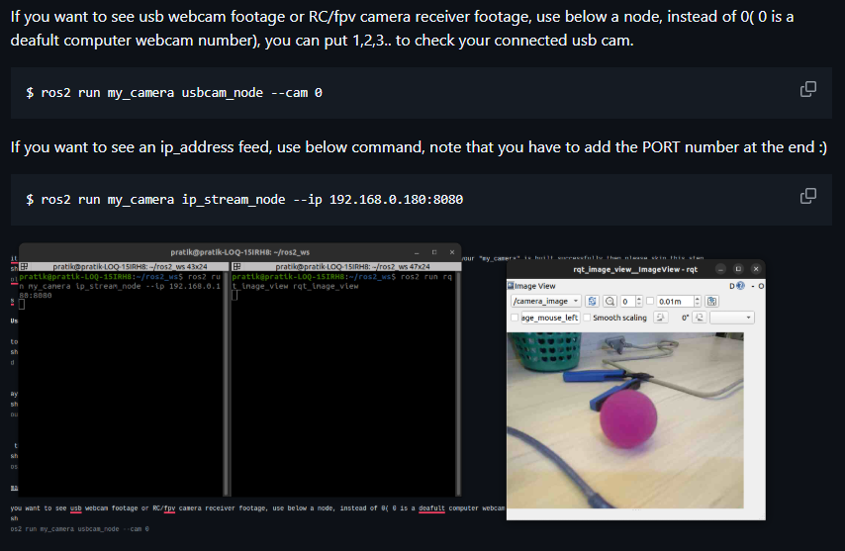
2
Robotics
ROS2
webcam
https://github.com/pratikPhadte/my_camera/tree/main

Slide 10
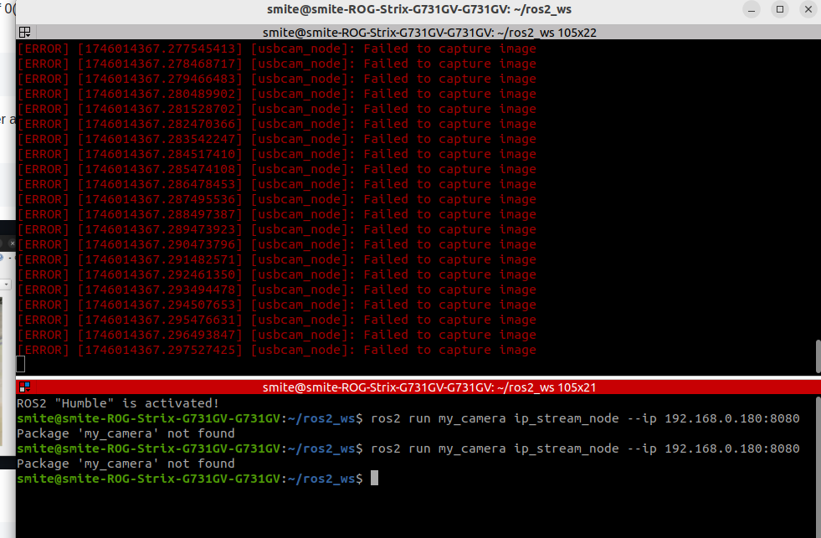
2
Robotics
ROS2
Webcam (원인 파악 중)
https://github.com/pratikPhadte/my_camera/tree/main

